Slide 1

General Linear Regression Model On 40 Yard Dash Times
Daniel Garcia
Notes:
1

Slide 2
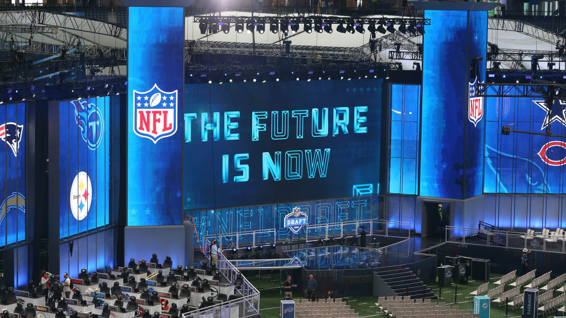
Background
NFL hosts a draft combine for the top prospects every year in February. The combine allows prospective athletes to perform skills drills that showcase their abilities . Some metrics taken are height, weight, 40-yard dash, bench press reps, vertical jump height, etc. This project aims to model the 40-yard-dash times for these athletes based on their performance in other areas.
Notes:
2

Slide 3
Interest
The ability to change direction quickly and move quickly is integral in football. For this reason, the 40-yard dash is one of the most valued metrics teams consider when choosing which players to draft. And since some players choose not to perform the 40-yard dash, we can predict with general linear regression what their time would be given other metrics.
Notes:
3

Slide 4
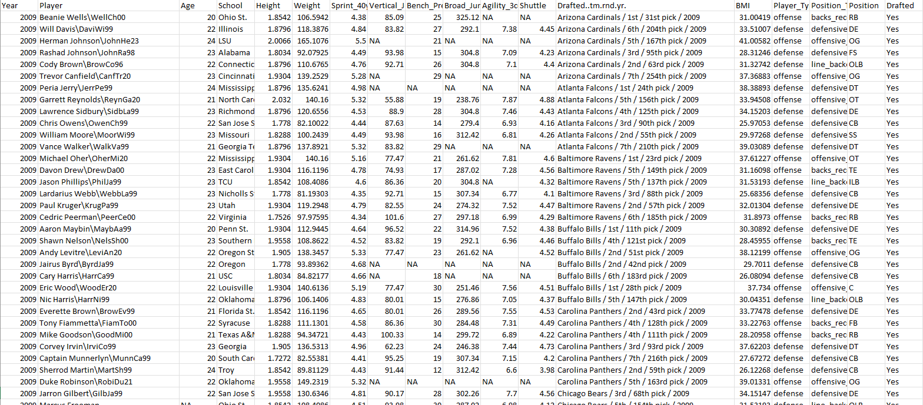
Data
The dataset came from Kaggle and it tracks all NFL combine participants since 2009, with 3,478 total participants.
For the purpose of this study, I am only regressing on the following positions: RB, CB, WR, SS
The reason for this is because these position groups are the fastest on the field and within the same speed tier. This allows me to get a normal response.
Notes:
4

Slide 5
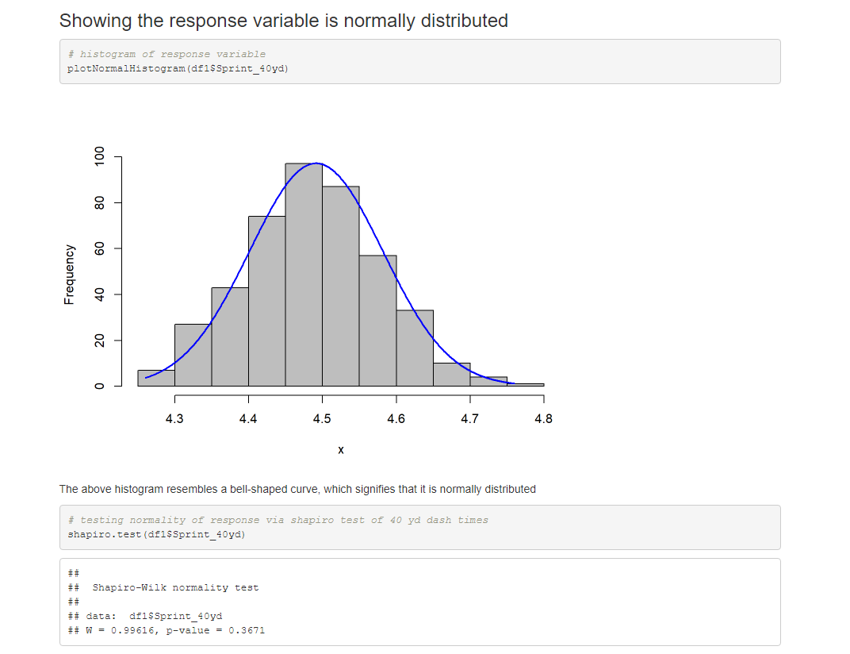
Normality of response
Showing our response variable (40 yard sprint) is normally distributed
The histogram of the response and the Shapiro test both verify that the response is normally distributed
Notes:
5

Slide 6
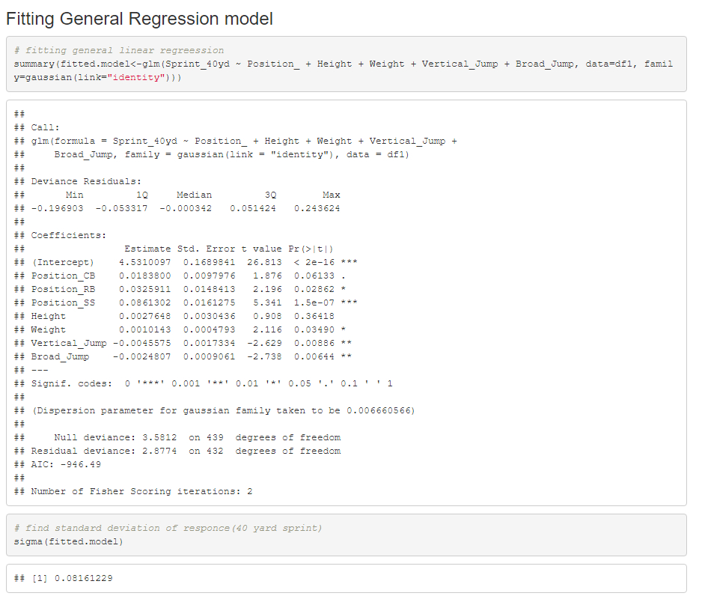
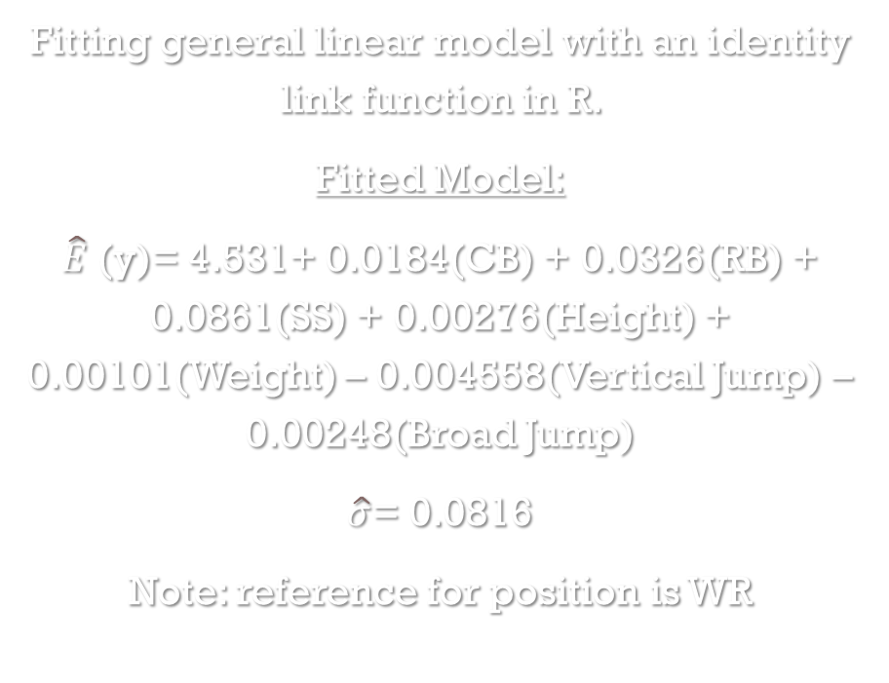
Fitting model
Fitting general linear model with an identity link function in R.
Fitted Model:
$\hat{E}$(y)= 4.531+ 0.0184(CB) + 0.0326(RB) + 0.0861(SS) + 0.00276(Height) + 0.00101(Weight) – 0.004558(Vertical Jump) – 0.00248(Broad Jump)
$\hat{σ}$= 0.0816
Note: reference for position is WR
Notes:
6

Slide 7
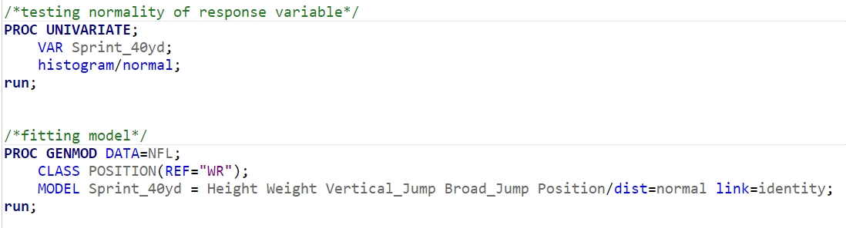
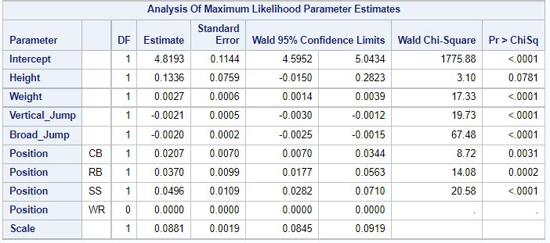
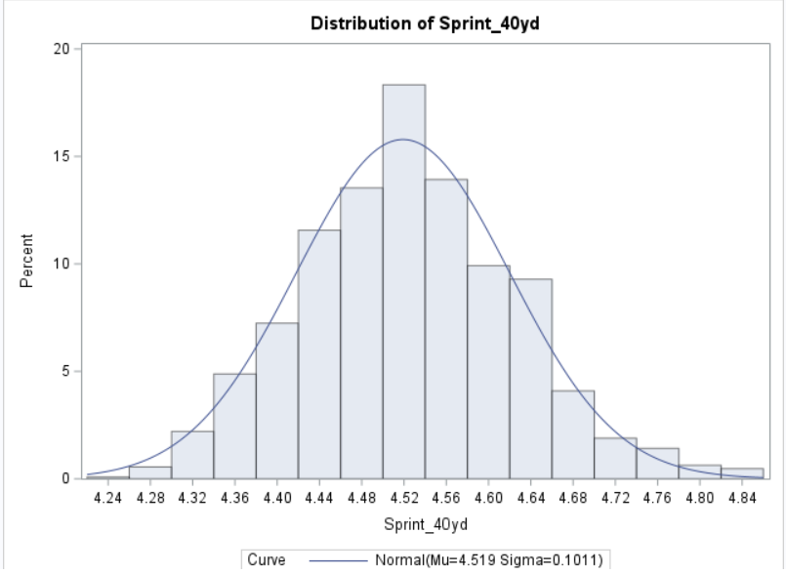
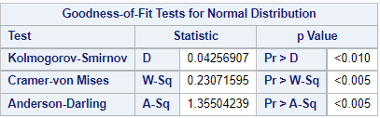
Sas

Slide 8
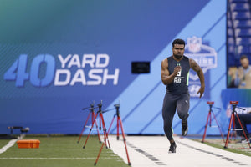
Predictors
Significant predictors at the 5% level of significance include:
Running back position
Strong safety position
Weight
Vertical Jump
Broad Jump
Notes:
8

Slide 9
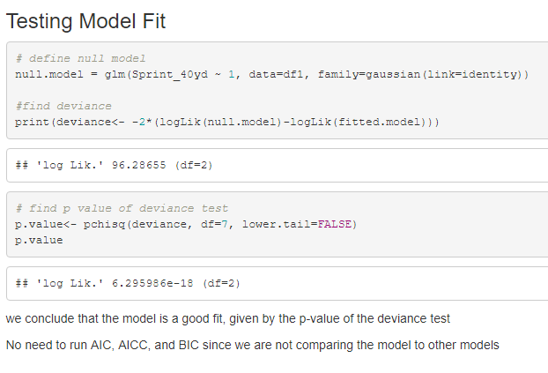
R Deviance test
We see from the p-value in the deviance test that we are in the rejection region. So we reject the null hypothesis that the null model is a better fit and use the fitted model.
Notes:
9

Slide 10
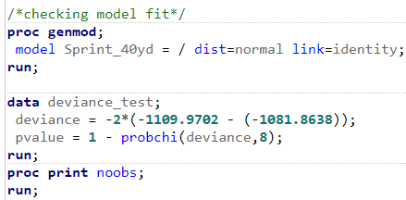
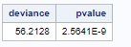
SAS Deviance test

Slide 11
Interpretation
The estimated average 40-yard sprint time is 0.0183 seconds higher for cornerbacks than it is for wide receivers.
The estimated average 40-yard sprint time is 0.0326 seconds higher for running backs than it is for wide receivers.
The estimated average 40-yard sprint time is 0.08613 seconds higher for strong safeties than it is for wide receivers.
As weight increases by a pound, the estimated average 40-yard sprint time increases by 0.00101 seconds.
As vertical jump increases by 1 inch, the estimated average 40-yard sprint time decreases by 0.00456 seconds.
As broad jump increases by an inch, the estimated average 40-yard sprint time decreases by 0.00248 seconds.

Slide 12
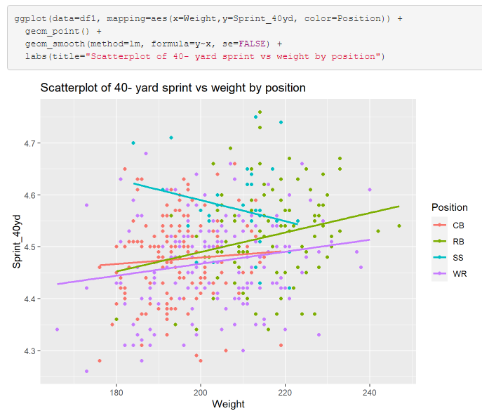
Analyzing the relationship between weight and speed
Notes:
12

Slide 13
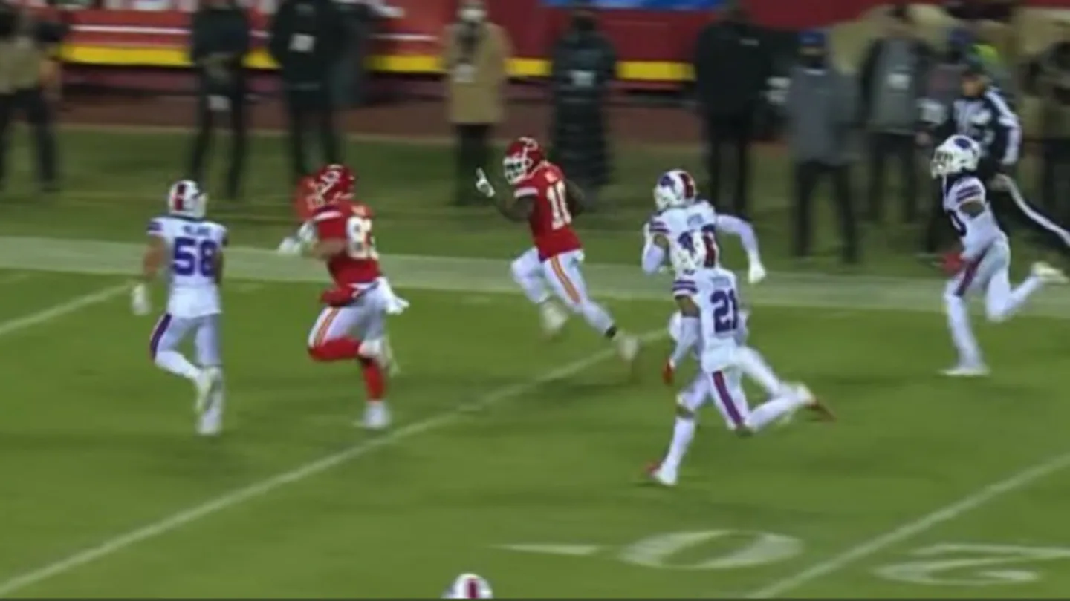
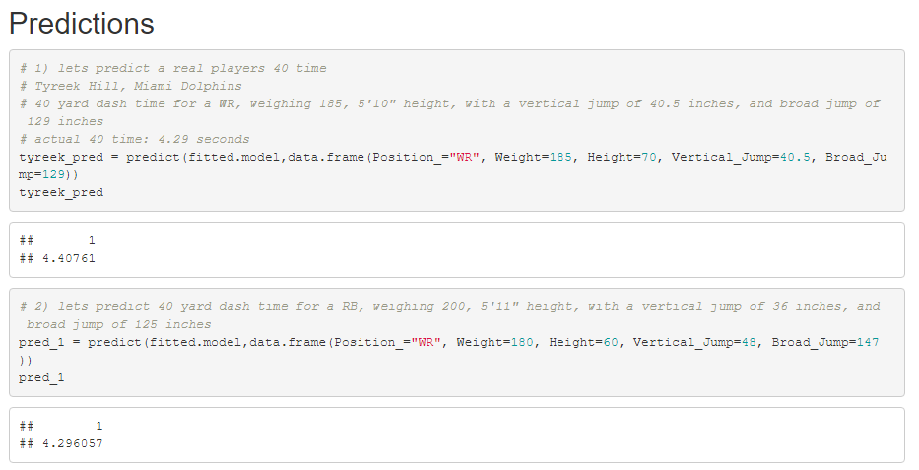
Predictions R
Based off Tyreek Hill’s performance in other areas, we predict him to run a 4.408 second 40 yard dash. He actually ran it in 4.29 seconds. He is an outlier
Notes:
13

Slide 14
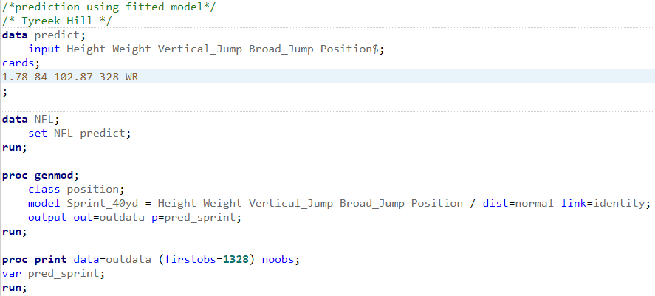
Predictions SAS

Slide 15
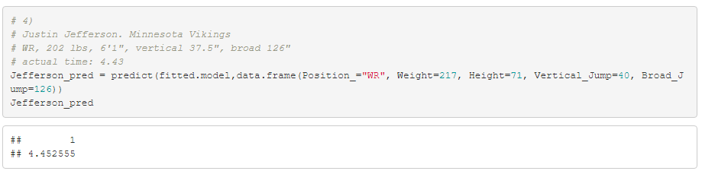
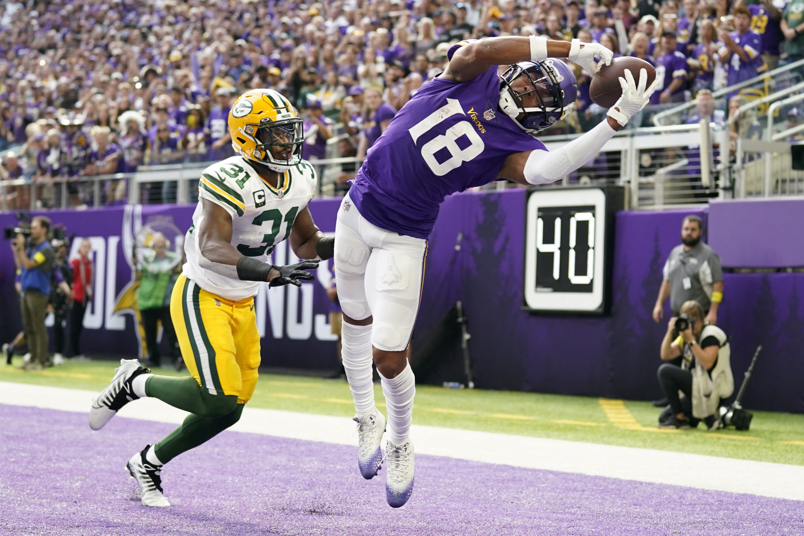
Predictions R
Based of Justin Jefferson’s performance in other areas, we expect him to run a 4.45 second 40-yard dash. He actually ran it in 4.43 seconds.
Notes:
15

Slide 16
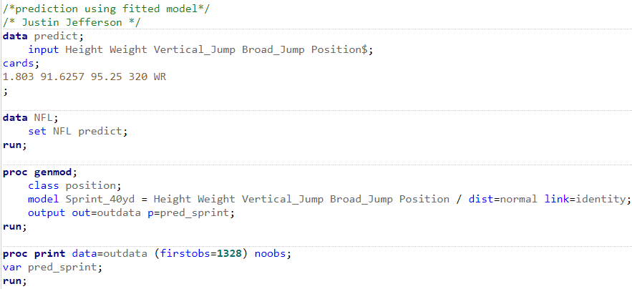
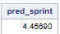
Predictions SAS

Slide 17
Future work
I’d like to try different models on different position groups and/or regress on a different variable.
Notes:
17

Slide 18

Thank you Dr. olga and classmates
Notes:
18

